Slide 2
Community Educator Training
Notes:
Ryan: Slides 12-44 Community Educator Presentation

Slide 3
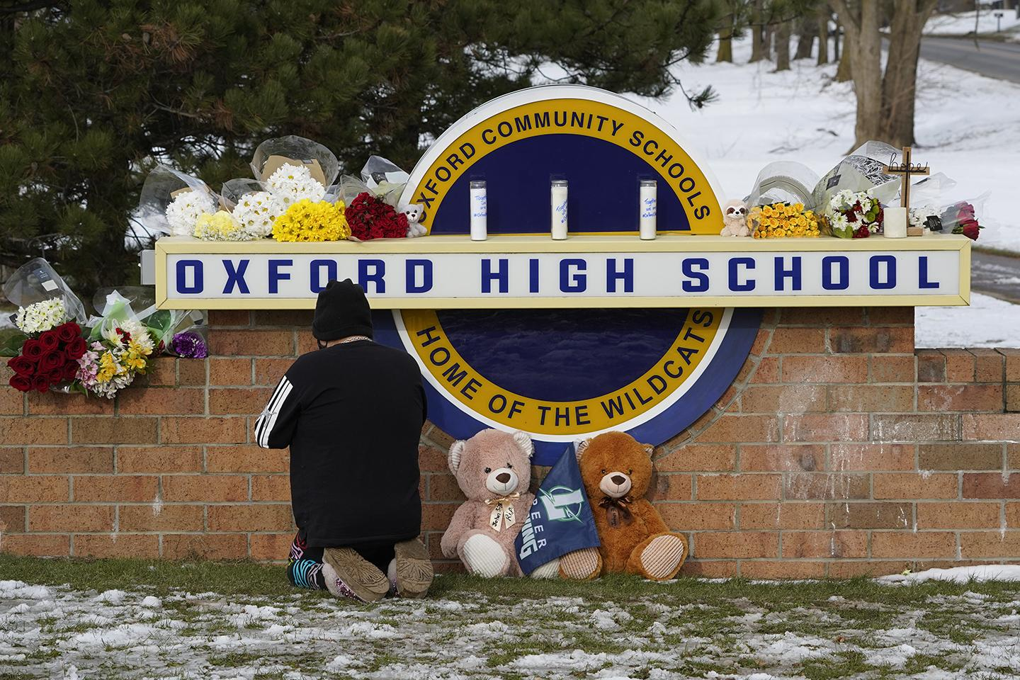
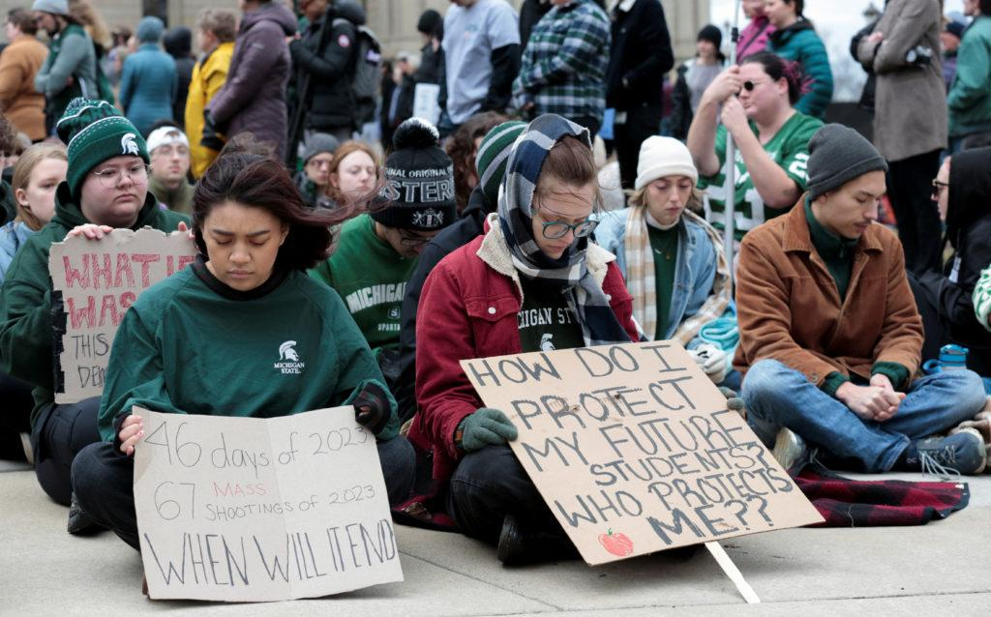
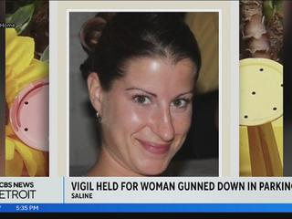
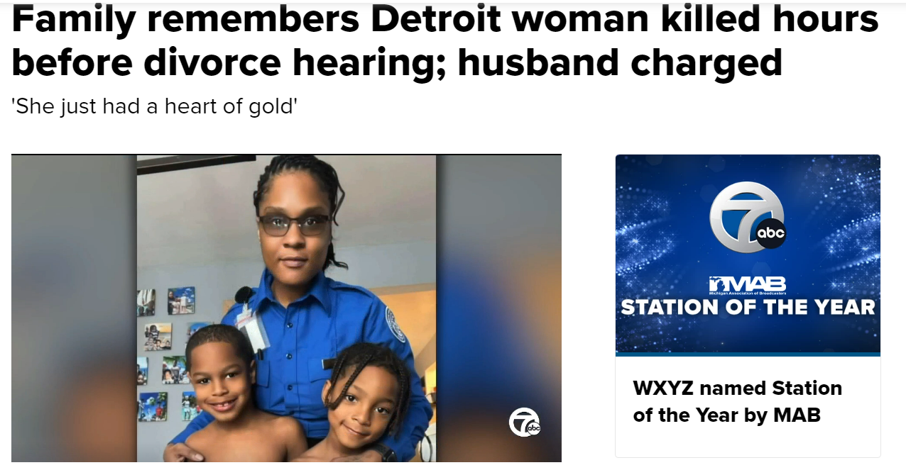
Notes:
Ryan

Slide 4
Approximately 1200 people are killed by guns each year in Michigan.

Slide 5
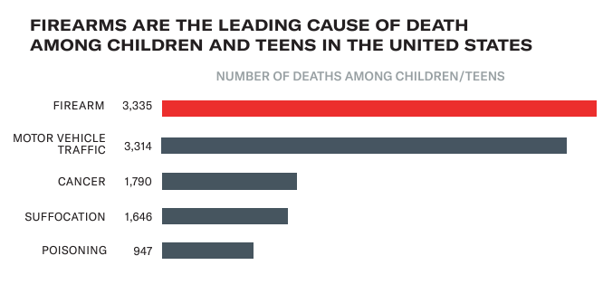

Slide 6
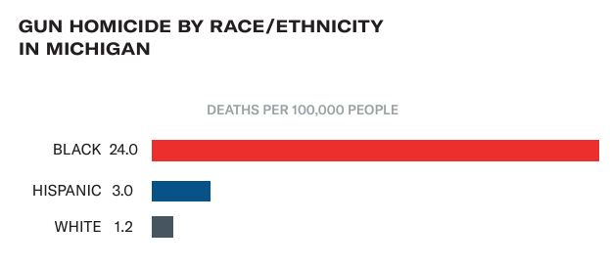

Slide 7
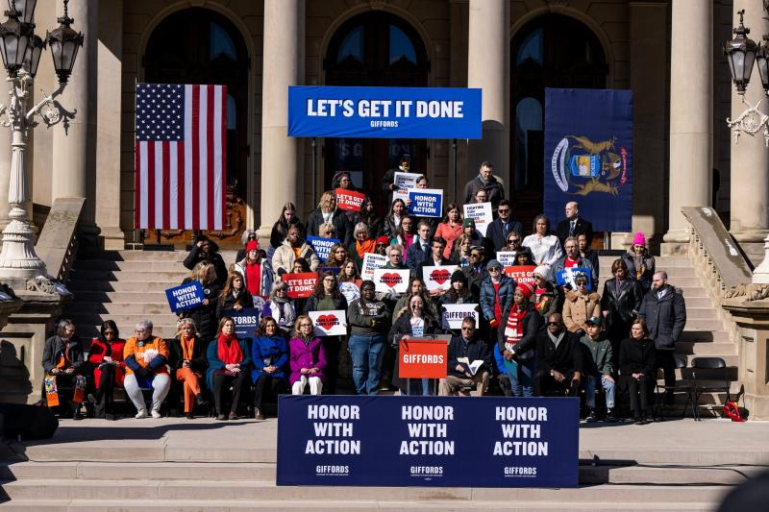
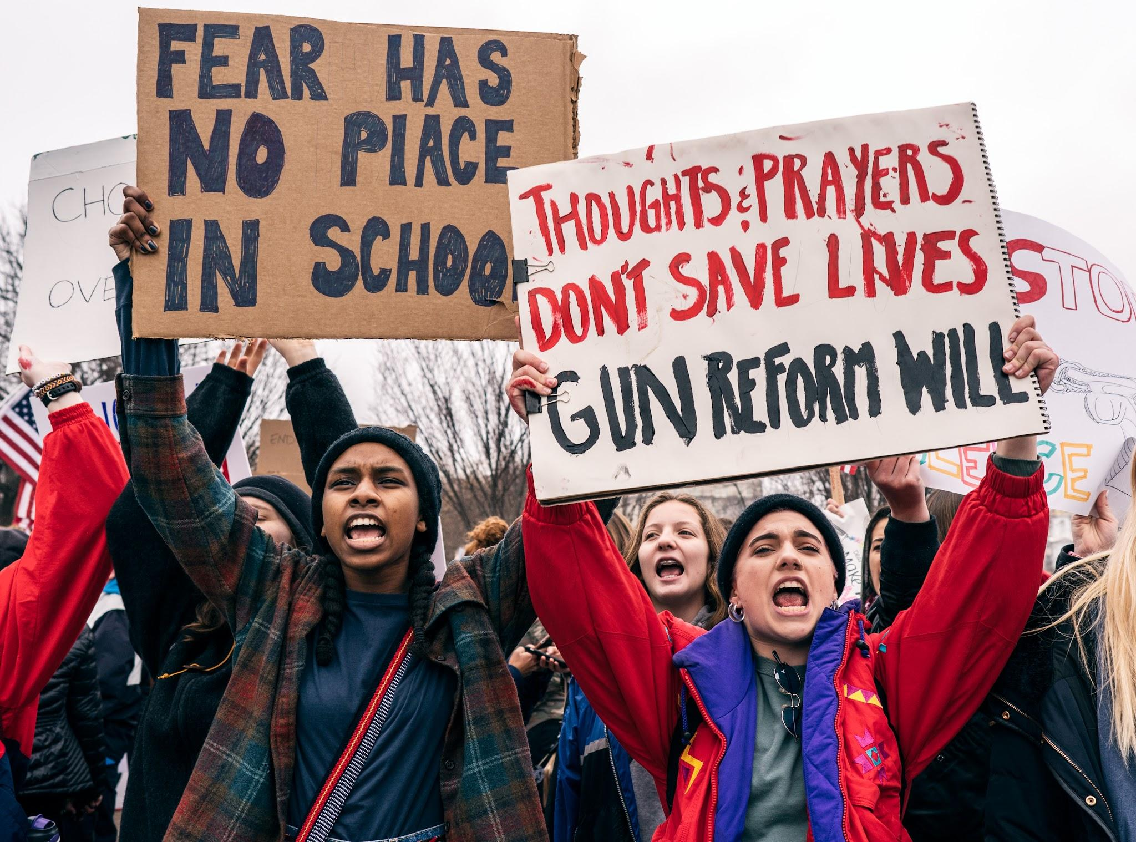

Slide 8
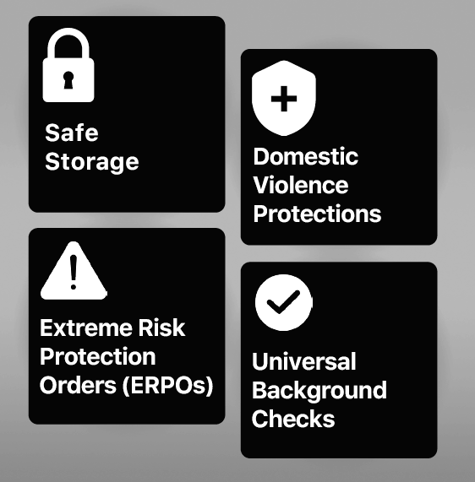
New Laws:

Slide 9
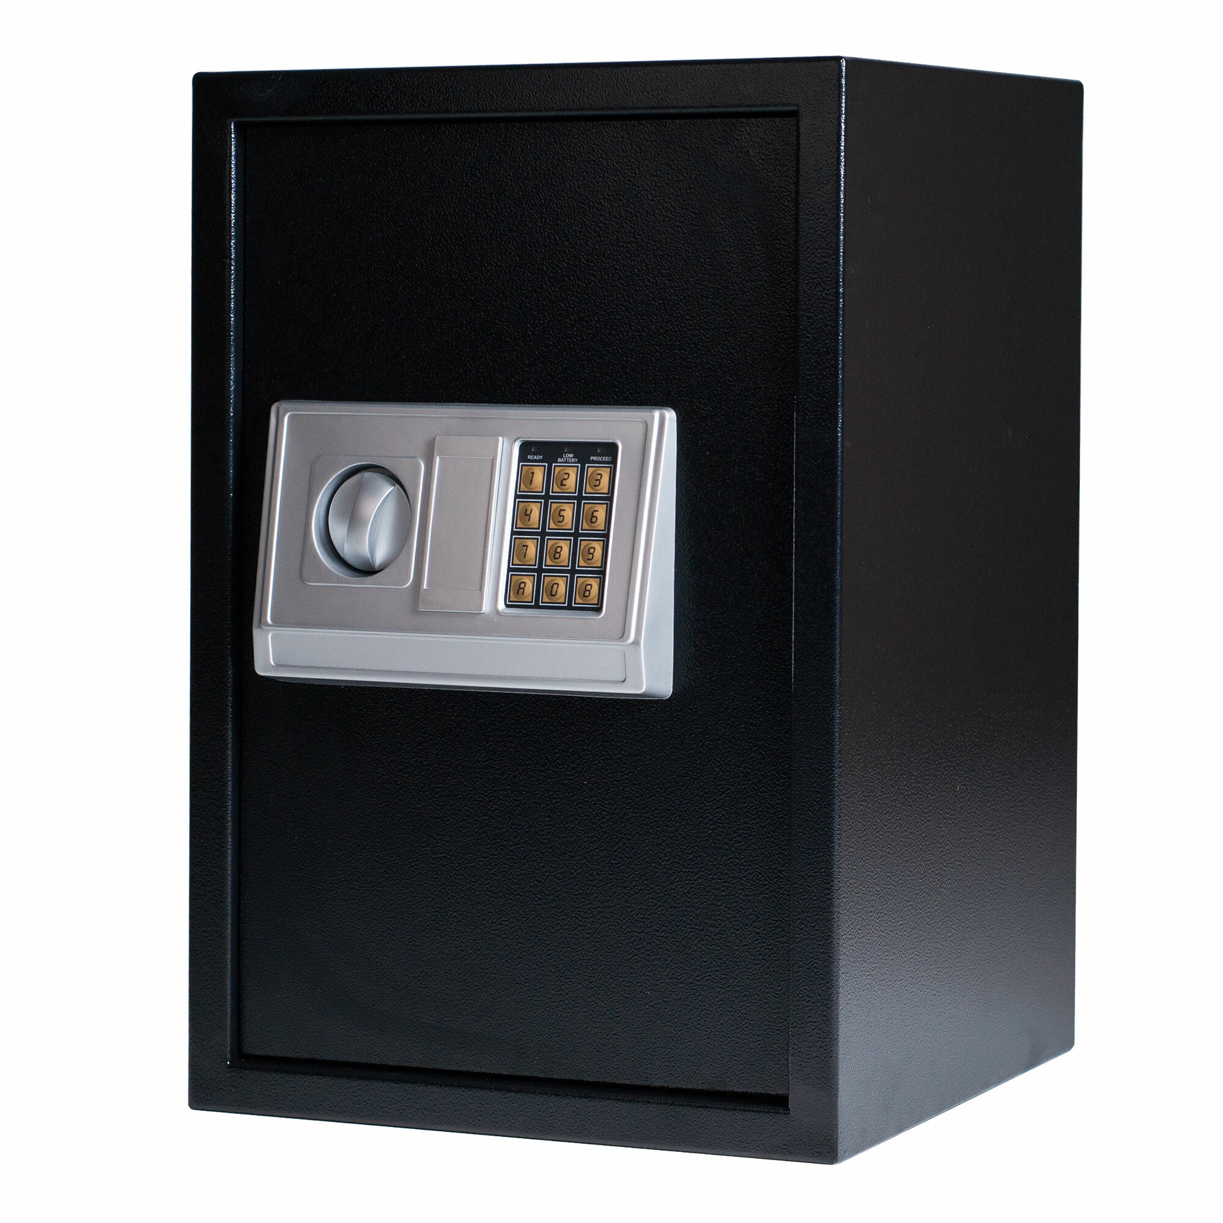
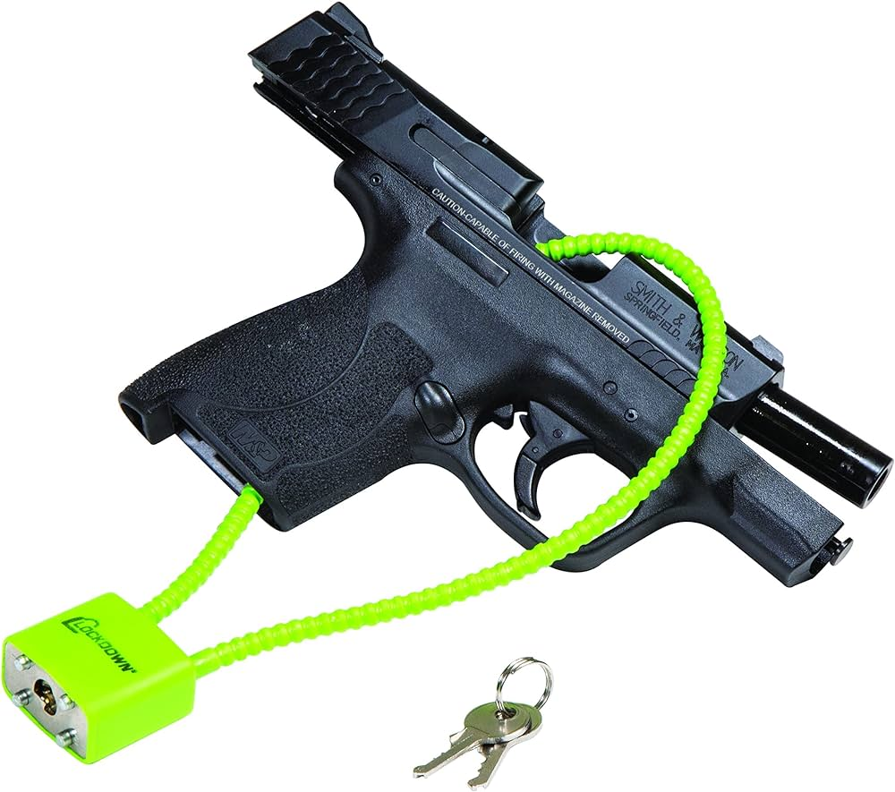
Safe Storage
Requires guns in homes with children to be secured with a lock or in a safe.

Slide 10
Safe Storage WORKS
Can result in up to 50% reduction in youth firearm deaths.
Most effective against unintentional shootings, suicides, and mass shootings.

Slide 11
Safe Storage Details
Law applies even if children are VISITING a home
Law applies if a gun owner is VISITING a home with children
Gun must be locked up or in owner’s control.

Slide 12
Safe Storage: Penalties and Enforcement
No one is coming to check on whether guns are safely stored. This law is only used if a child actually gets access to a weapon.
Child access, but no injury: 5 years and $5,000 fine
Access results in injury: 10 years and $7,500 fine
Access results in death: 15 years and $10,000 fine

Slide 13
How should I secure my firearm?
Firearm should be stored UNLOADED.
Gun safes with a biometric (fingerprint) lock are the best.
Simple hand gun safes are available at Wal-Mart or Amazon for less than $30.
Keep your safe keys ON YOU.
Cable locks that thread through the magazine and chamber and are available free of charge at county MDHHS offices and some local health departments

Slide 14
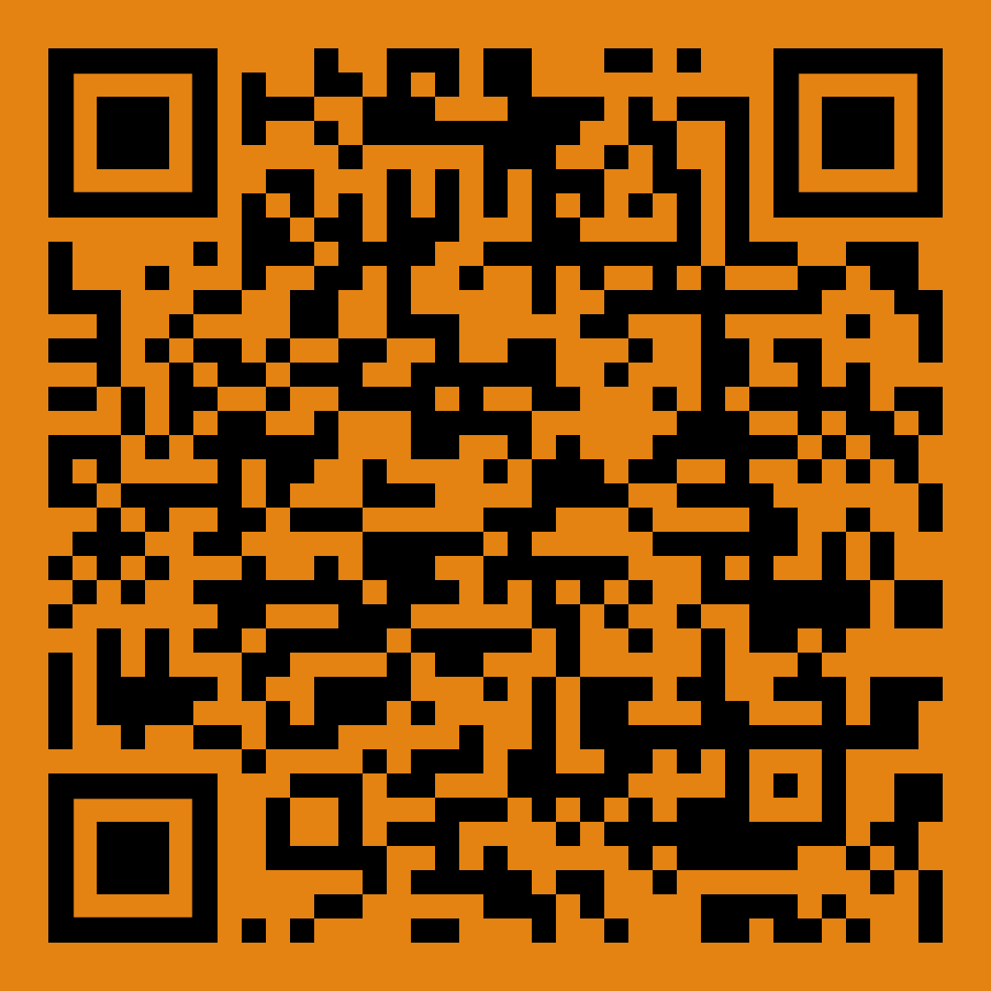
More Information on Safe Storage:

Slide 15
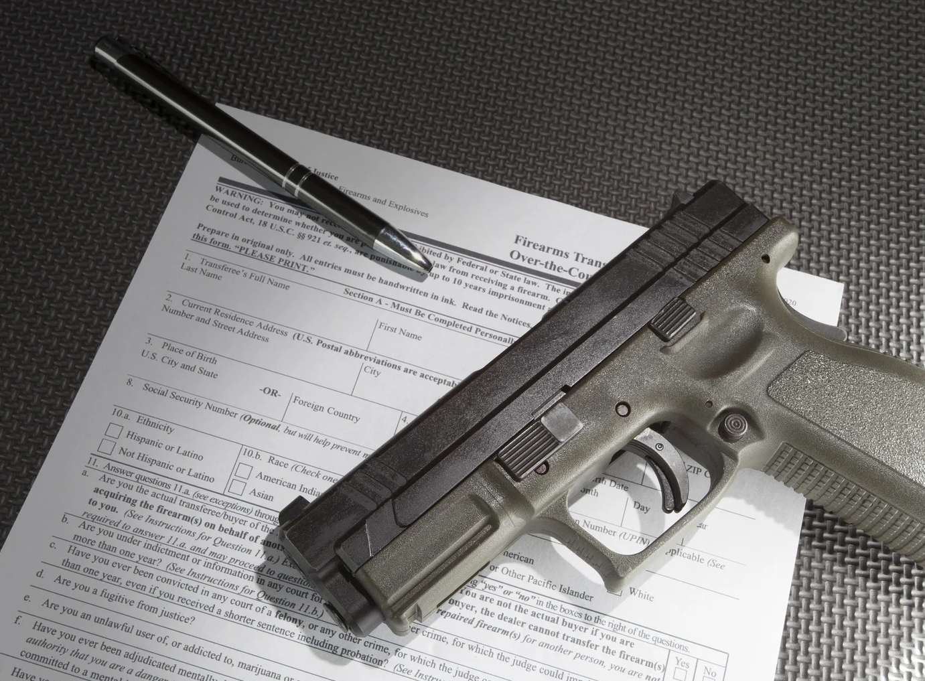
Universal Background Checks
Closes the private party (or “gun show”) loophole

Slide 16
Purpose of Background Checks
Background checks prevent people who are not legally allowed to buy a gun from purchasing one
Every year, background checks stop more than 300,000 illegal gun sales.
Notes:
For example, background checks prevent those with criminal records or disqualifying mental health conditions from purchasing guns.

Slide 17
How to Purchase
Any licensed gun dealer or police department can run the background check.
Afterwards, if the individual passes the background check, they will provide a permit to purchase.
A gun dealer will require the firearm be brought in, but the police will not.

Slide 18
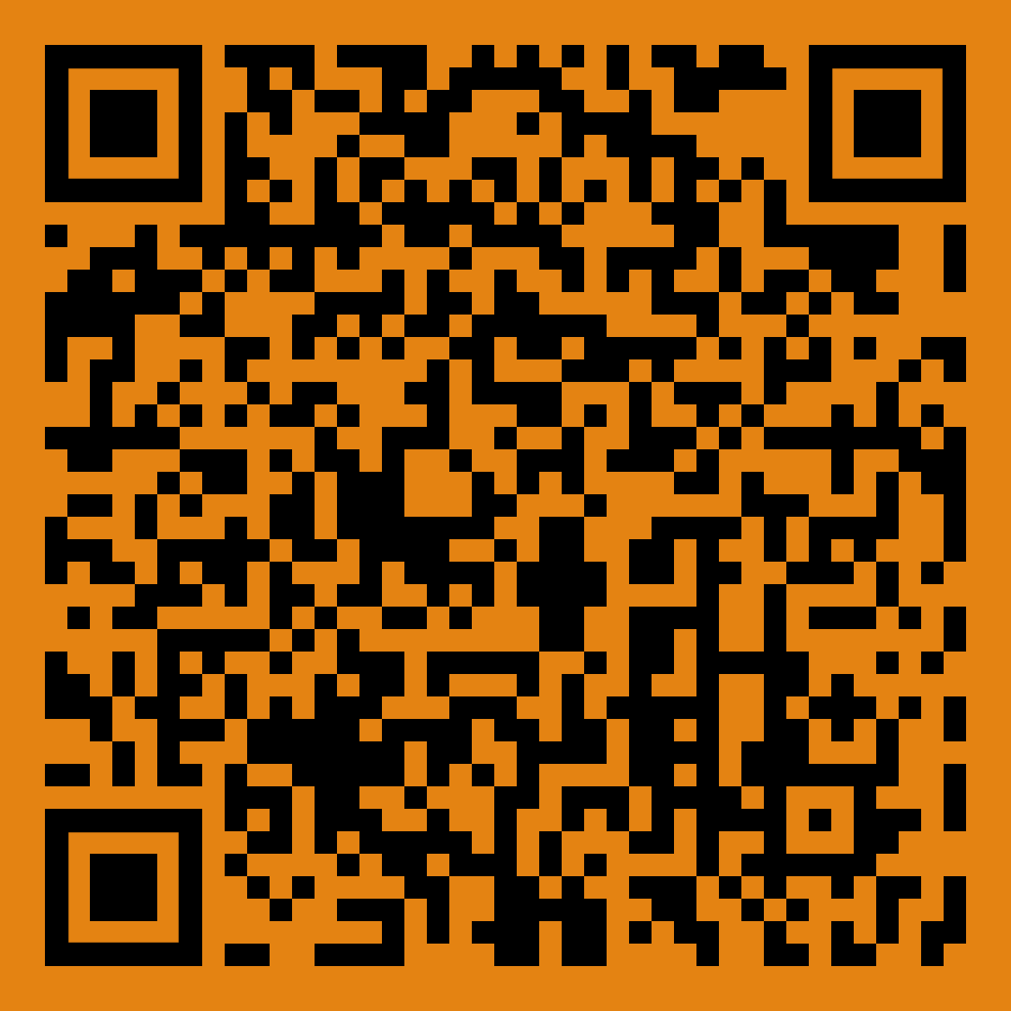
More Information on
Universal Background Checks:

Slide 19
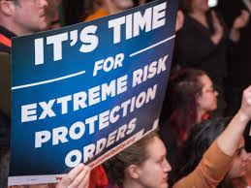
Extreme Risk Protection Orders
Allows family, law enforcement, medical professionals, and more to petition the court to temporarily remove the firearms of someone who has become a significant threat to themselves or others.

Slide 20
ERPOs Save Lives
1 suicide is prevented for every 10-20 reports
ERPO’s have been used in Michigan to stop abusers and in other states to prevent suicides, domestic violence, interpersonal violence, and mass violence.
*You don’t have to be a policy expert, we will support you
and provide resources.

Slide 21
When to Use an ERPO
Someone exhibits suicidal ideation, thoughts, planning, etc.
Domestic violence.
Threats of interpersonal or mass violence.
Signs of a severe mental health crisis.

Slide 22
Who Can File an ERPO in Michigan?
Family members
Romantic partner or ex-romantic partner
Those who live with the at-risk individual
Law enforcement
Health professionals

Slide 23
What is needed to file an ERPO?
The form “Complaint for Extreme Risk Protection Order”
Evidence that the subject has become a danger to themselves or others.
Police reports, text messages, or any other documents.
Statements from witnesses, including the petitioner.

Slide 24
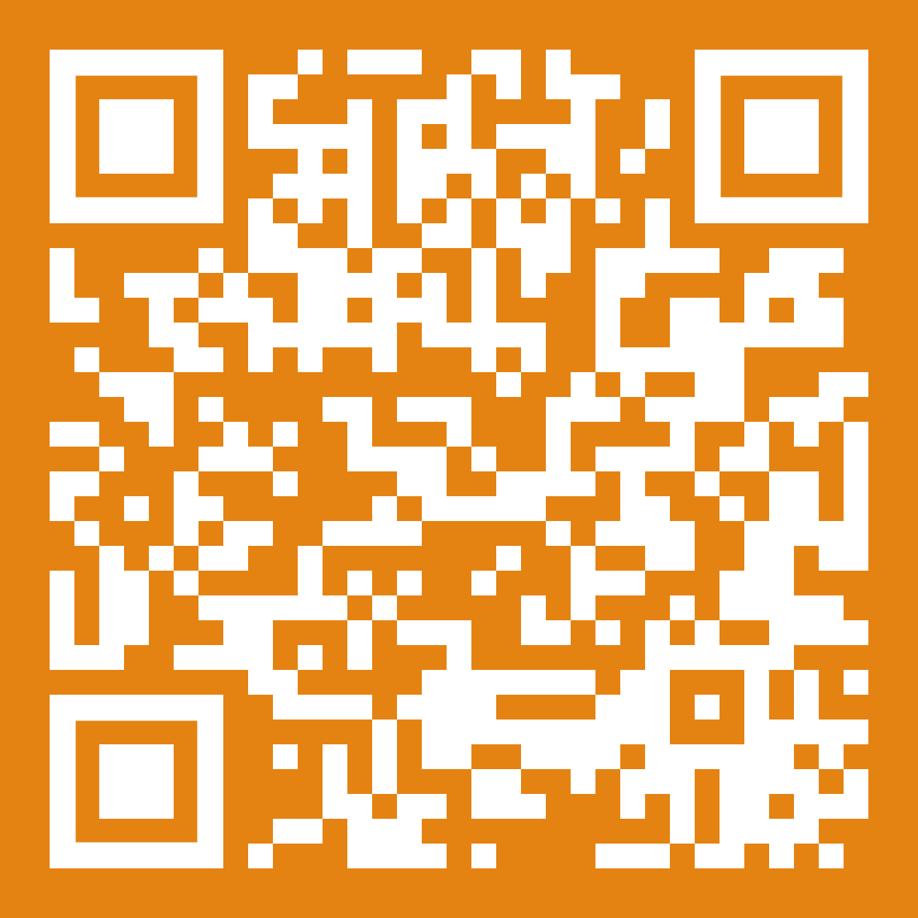
ERPO Forms
Step by step ERPO filing process:
Notes:
*reminder: you do not need to be a policy expert, we have resources that we will provide

Slide 25
The ERPO Hearing
There is a hearing before a judge based on the evidence presented.
If the order is not “ex parte” (emergency), both sides can present evidence.

Slide 26
“Ex Parte” = Emergency
If you ask for an “ex parte” order, the judge will decide before a hearing.
This is to be used when there is an immediate threat.

Slide 27
After The ERPO Hearing
If the judge grants the order, the subject will be ordered to turn their weapons in to the police or the police may collect the weapon immediately.
The subject cannot possess or purchase firearms for 1 year.
The subject can appeal if they disagree.

Slide 28
Extreme Risk Protection Order (ERPO)
+
Personal Protection Order (PPO)
ERPO’s only deal with guns.
Personal Protection Orders (sometimes called a restraining order) can ALSO order that a subject stay away from you or not contact you. A judge can impose other restrictions to protect you.
Some individuals may want to consider filing a PPO and ERPO together.
PPO resources: www.michiganlegalhelp.org

Slide 29
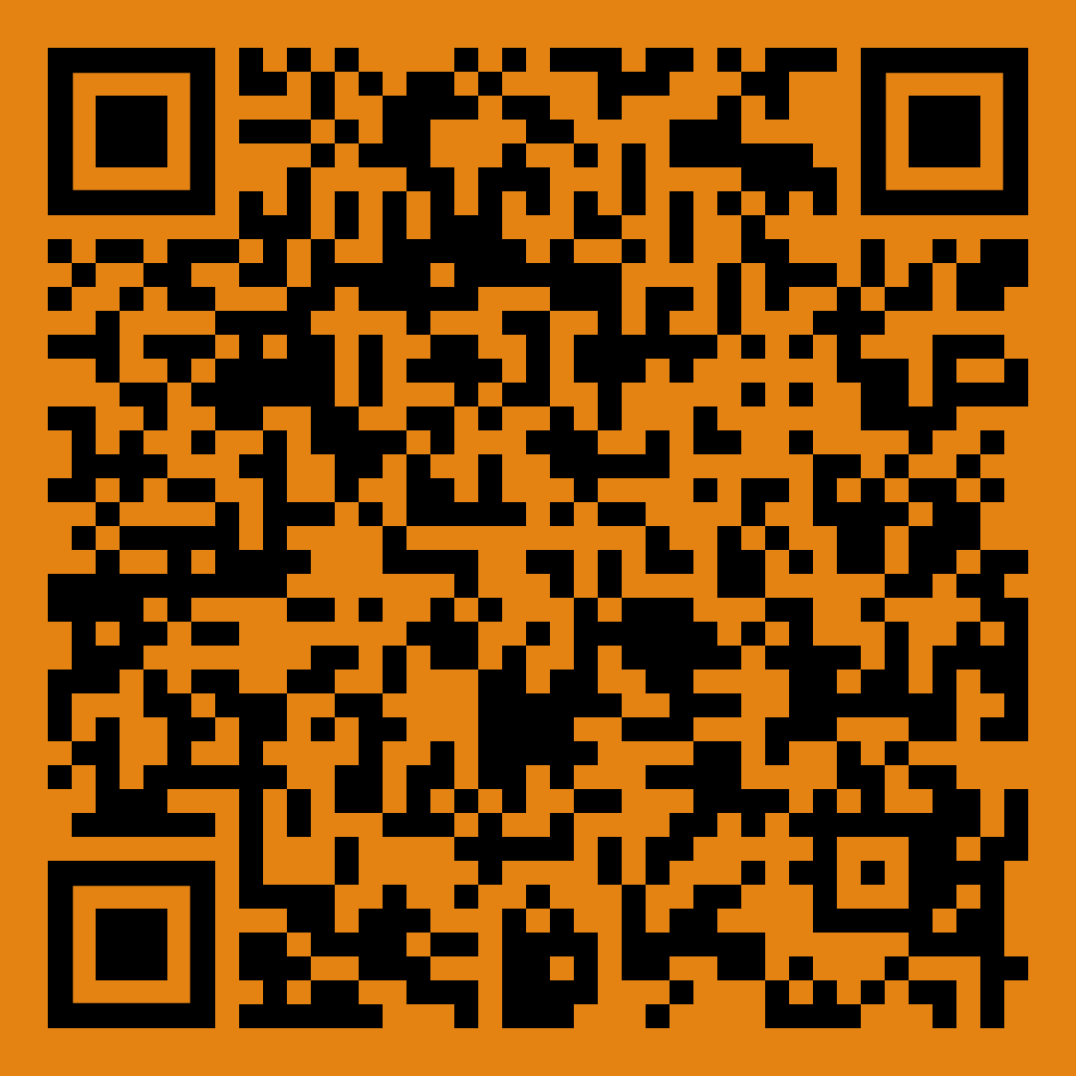
More Information on ERPOs:

Slide 30
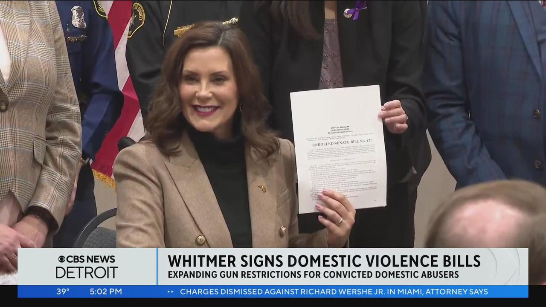
Domestic Violence Firearm Protection
Anyone convicted of a domestic violence felony OR misdemeanor cannot possess or own firearms for 8 years after the completion of their sentence.

Slide 31
Domestic Violence Homicide
70 Michigan women and children are killed each year by an abuser with a gun.
Domestic abuse is 5 times more likely to turn deadly if the abuser has access to a firearm

Slide 32
Activating the Domestic Violence Protection
The DV law prevents the abuser from buying new guns, but does not remove any that they already have.
An ERPO can be filed to ensure the removal of firearms the abuser currently has.

Slide 33
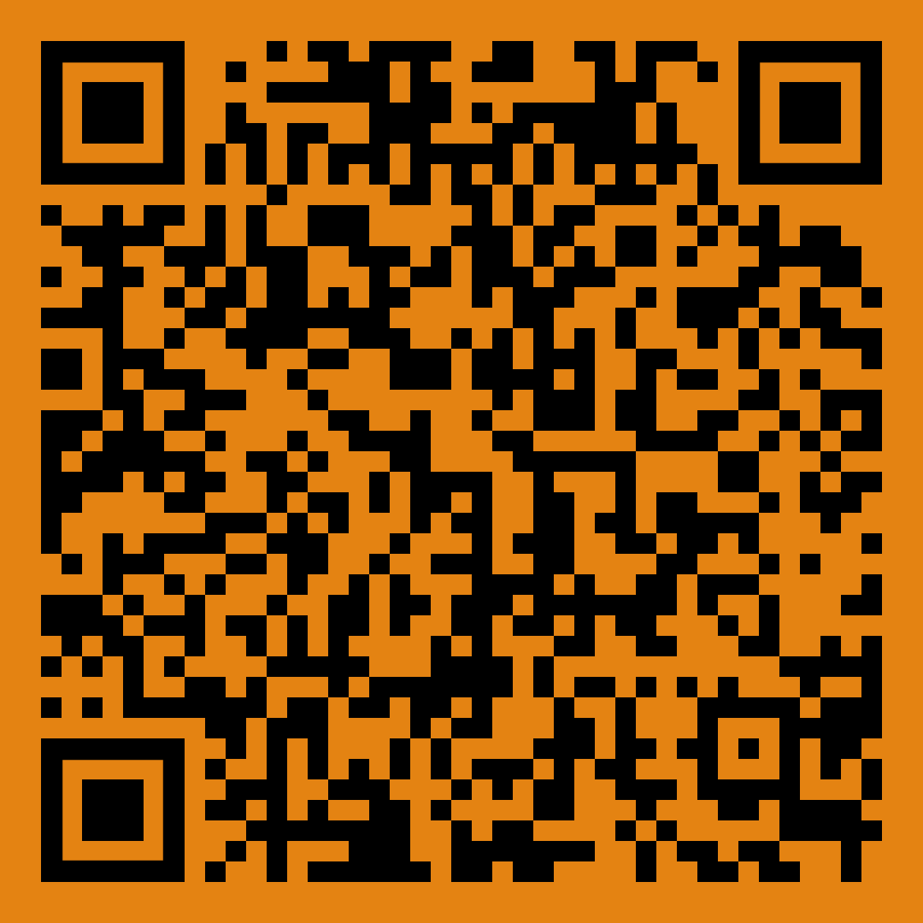
More Information on the DV law:

Slide 34
What can you do?
Register and vote!
Become a community educator.
Help us work with your schools and police departments.

Slide 35
END OF PRESENTATION

